Slide 1

DOAA CA2
Emotive
Name: Muhammad Faqih Akmal & Oh Tien Cheng
ID: P2012030 & P2012072
Class: DAAA/FT/2B/01

Slide 2
Agenda
Introduction
System Architecture & Libraries
Pages & Features
Login/Register
Home
Predict
Result
History
Dashboard
APIs
Model
Testing

Slide 3
Introduction
Purpose of Project
To create a Flask Web Application that uses a Deep Learning model to classify images fed from a Web Camera
To store the images and predictions based on user
Scope of Project
Face emotion detection using a Camera

Slide 4
Architecture & Libraries
Database
Front End
SQLite/
Postgres (Heroku)
Flask
Login / Register
PyTest, SQLAlchemy
Flask-Login, Flask-WTF,
WTForms, Werkzeug
(Heroku)
Home
Predict
Result
History
AI Model & Statistics
Dashboard
TensorFlow, NumPy
(TensorFlow Serving)
HTML, JS, CSS, Bootstrap 5, Jinja, Plotly
(Heroku)

Slide 5
General Features
Authentication
All pages except the home page requires authentication
Predictions are stored based on User
Different user sees different prediction history
Mobile Friendly Interface
All pages are viewable on mobile devices
These pages include Camera, Result, History & Dashboard

Slide 6
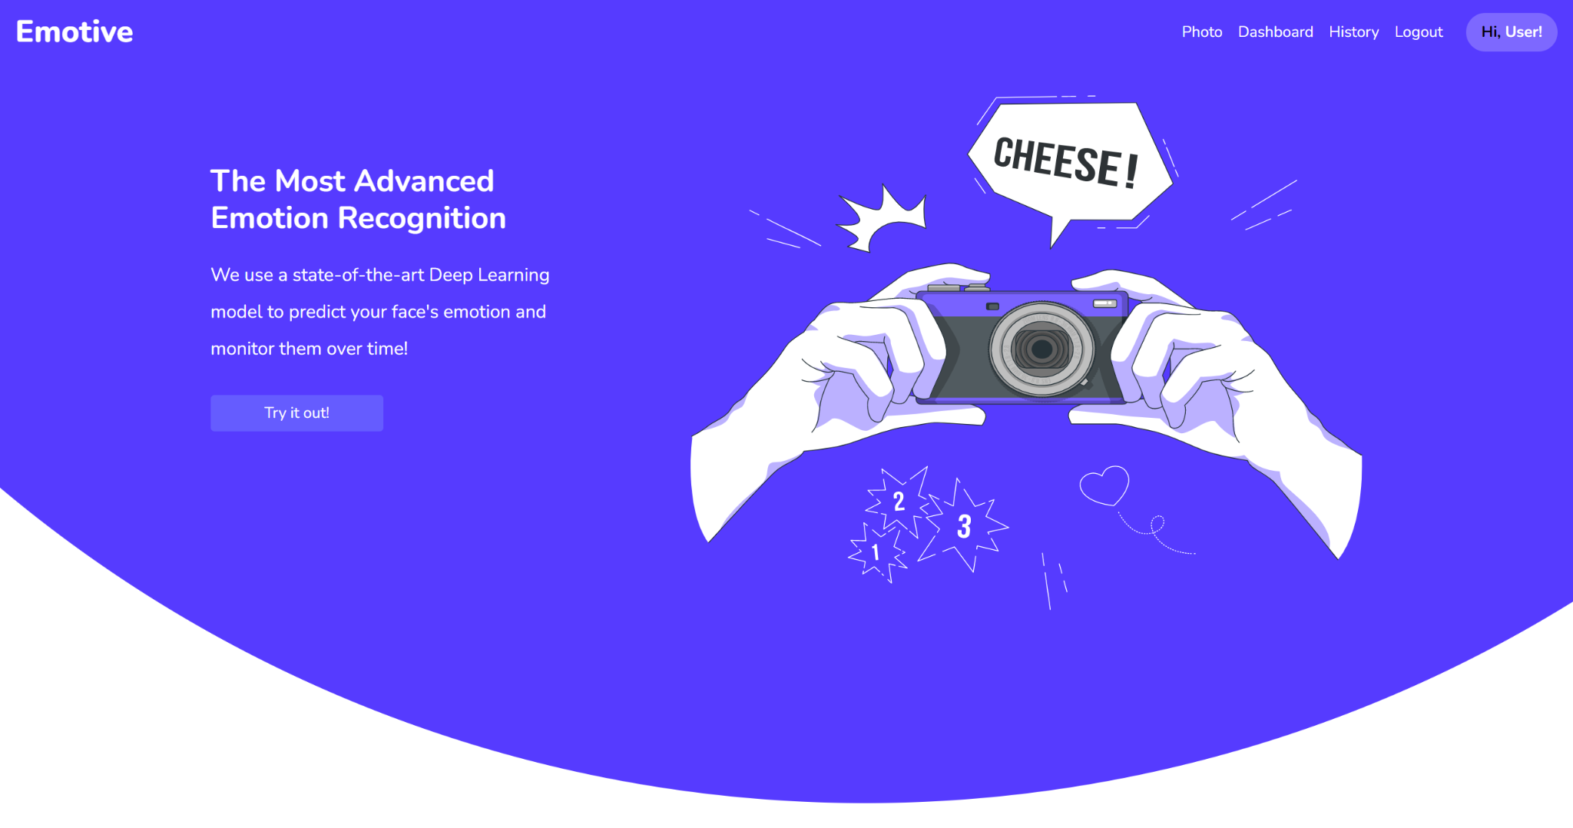
Home Page
(1) Once logged in, the username is always shown on the header for clarity.

Slide 7
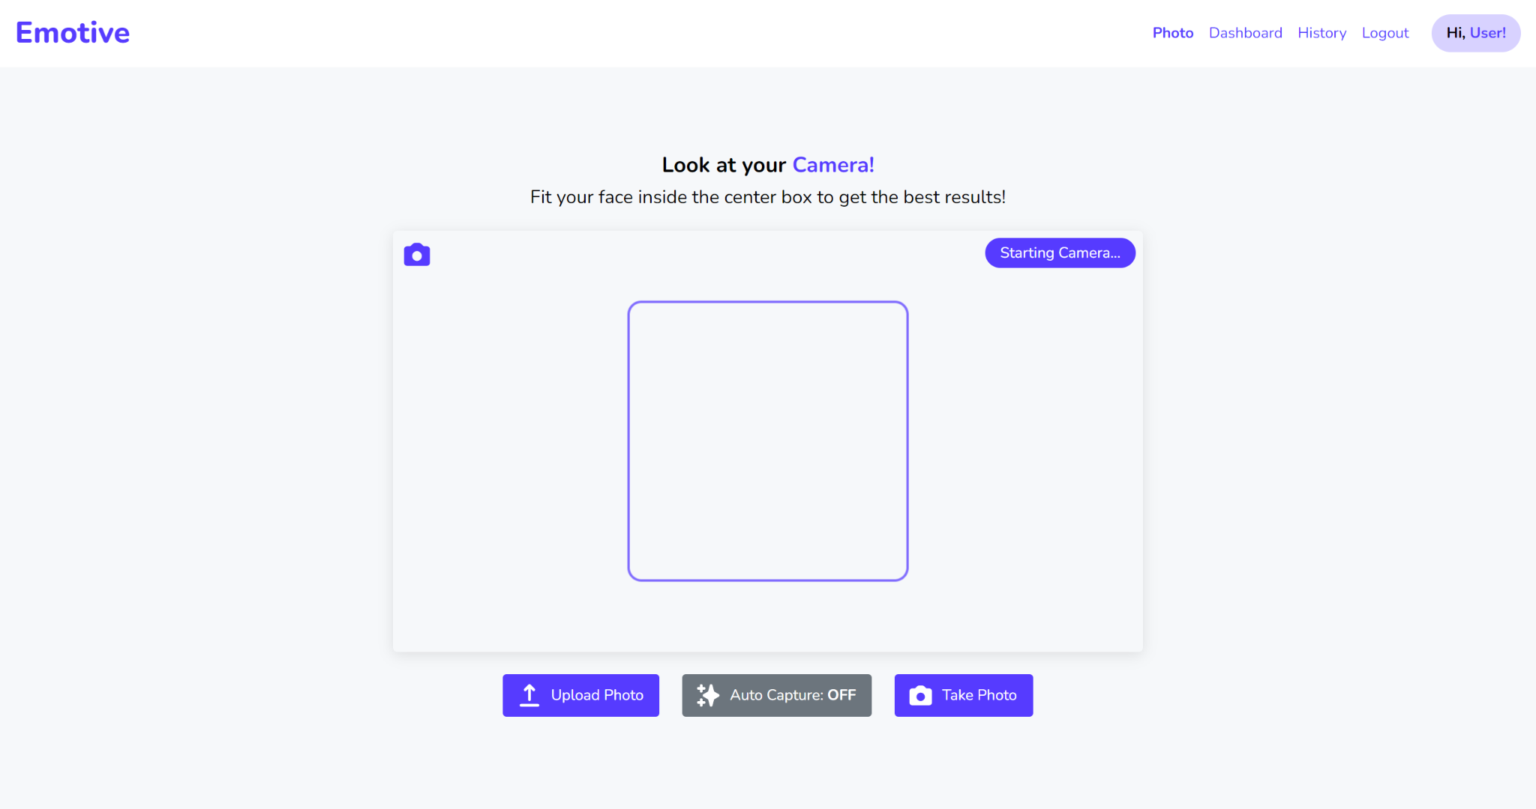
Predict Page (1)
(1) The predict page contains the header and the rectangular camera.
(3) There is also an indicator on the top right to show the current state of the camera.
(2) There is a square box in the middle of the camera feed to guide the user to the center. More on this later!
(4) There are 2 buttons at the bottom.
Take Photo: Users can click the button to capture their face in the webcam.
Upload Photo: Users can click the button to upload their photos.

Slide 8
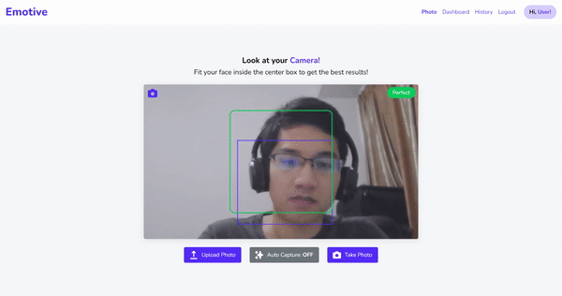
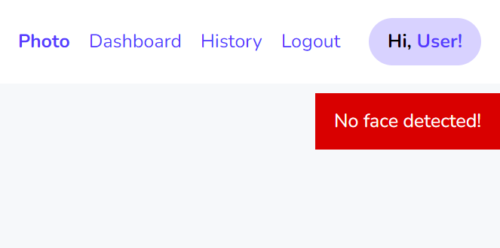
Predict Page (2)
Face Tracking: If a face is detected, the user’s face will be tracked with a purple box.
3 Live Camera States:
Perfect (Green)
The user is perfectly centered
Move to the box (Orange)
The user is not centered
No face detected (Red)
No face is detected
This ensures the user’s face is centred when the photo is taken. Even if the face is not centered, we have an additional model in the backend that crops the image to the user’s face.
Once the image is sent, if no face is detected, the page will show a warning that “No face is detected!” before redirecting back.
(1) Once logged in, the user is always shown on the header for clarity.

Slide 9
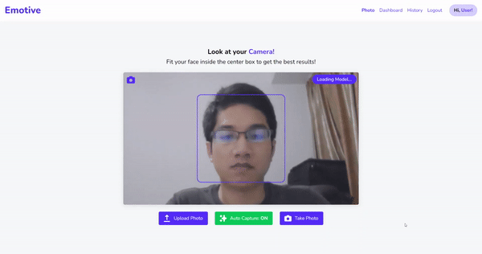
Predict Page (3)
Auto Capture
Auto Capture is a feature that is enabled by default and can be turned on or off in the Predict page as well as the Dashboard page.
If a user’s face is centred for 3 seconds, then the app will automatically capture the image and move on to prediction.
Auto Capture ensures effortless photo taking without pressing any button.
The feature is disabled on mobile devices due to insufficient computing power compared to most laptops or PCs.
(1) Once logged in, the user is always shown on the header for clarity.

Slide 10
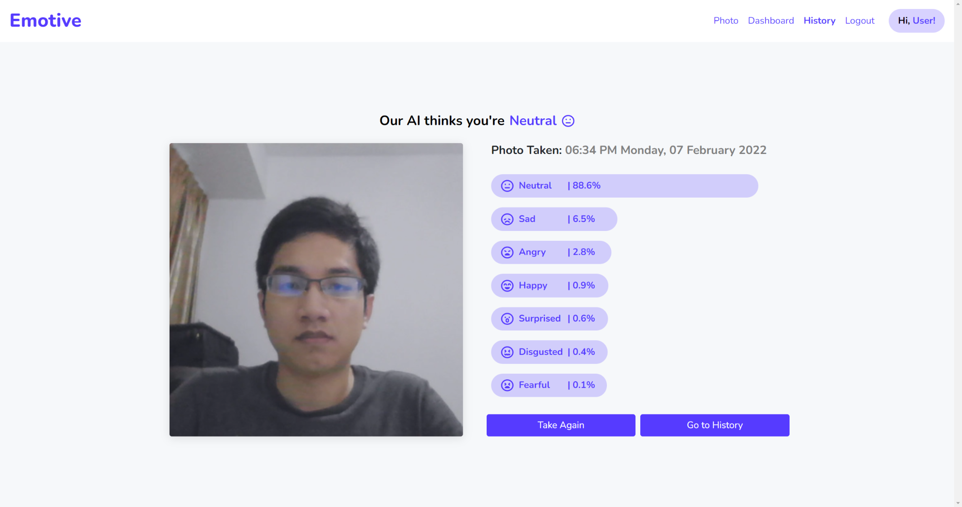
Results Page
(3) The page also shows the date & time when the photo was captured.
(1) The results page shows the prediction of the image in the title which in this case is “neutral”.
(4) The page also shows the confidence of the AI model. In this case, it is 88.6% confident that the face is “Neutral”.
(2) The captured image is displayed to the left side of the screen.
(5) Last but not least, the user can either take photo again or go to the History page.

Slide 11
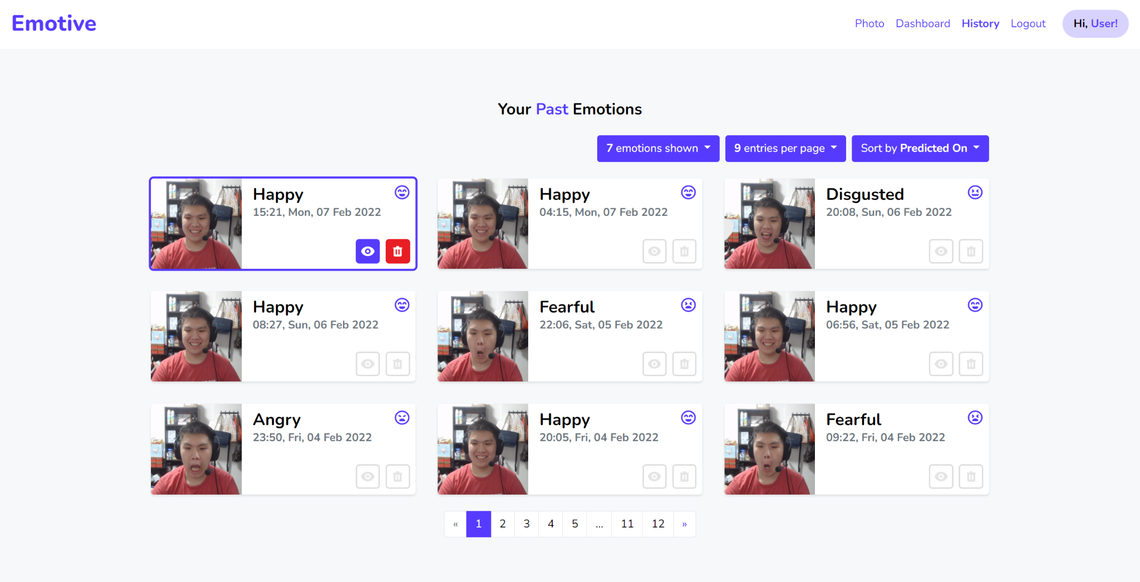
History Page
(1) All of the predictions of the user will be shown in this history page.
(5) This page also has 3 filters so that users can filter the predictions they wanted.
The filters are:
1. Emotions Filter
2. Entries Per Page
3. History Sorting
(2) Each card is a prediction that contains the photo, the predicted emotion and the date taken.
(3) Each card also has 2 buttons. One to view back the prediction & the other to delete.
(4) This page has a pagination feature so that users do not have to see their history all at once.

Slide 12
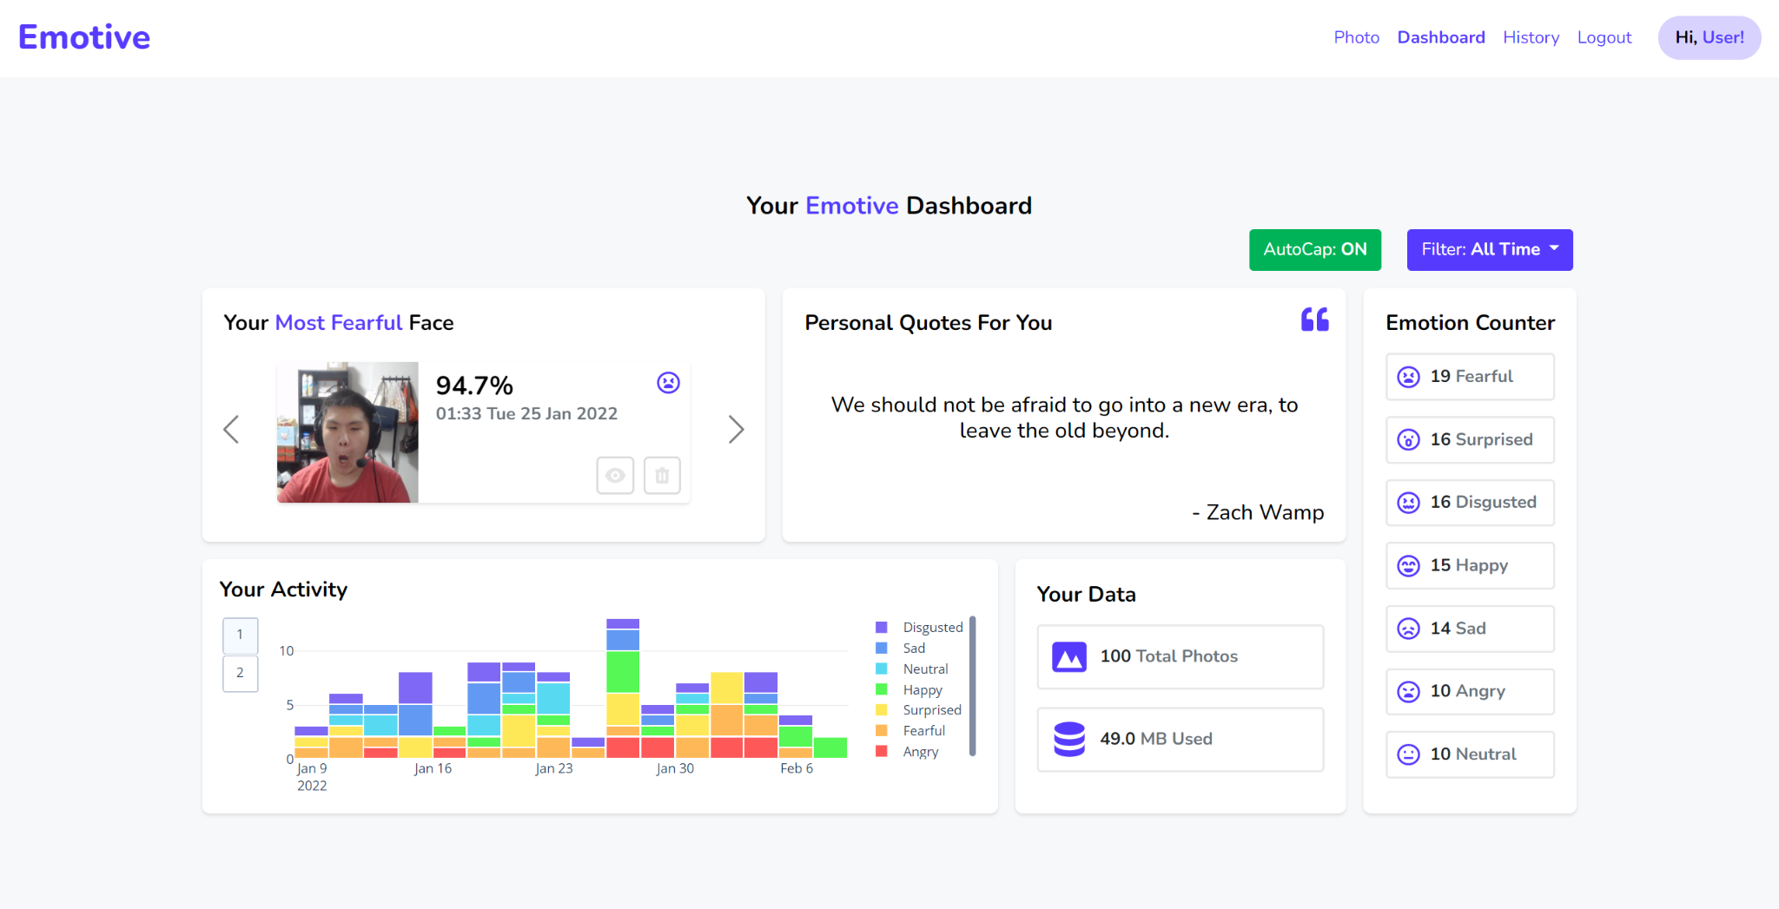
Dashboard Page (1)
(1) The dashboard is a statistical and personal summary of the user’s usage on the web application.
(4) The personal quotes section is shown based on the most prominent emotion of the user. In this case, he was fearful.
(6) At the top right, Auto Capture can be toggled here. The page can be filtered from “1 Day” to “All Time”. This will show the user’s summary for different time periods.
(2) The top left section is a sliding carousel that shows the face with the highest confidence of the AI model for the particular emotion.
(7) The emotion counter shows the count of predictions that corresponds to the emotion. Clicking on them will show the History page with only that emotion.
(3) The bottom left shows the user’s emotion over a period of time. More about this in the next slide.
(5) “Your Data” section shows the total number of photos and the amount of storage used.

Slide 13
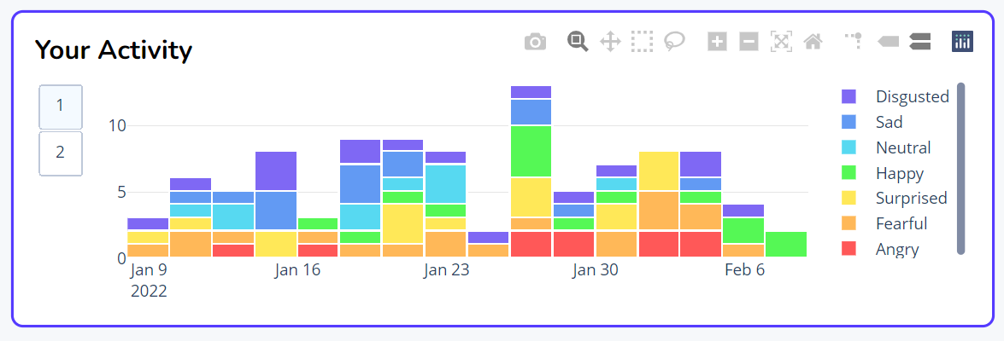
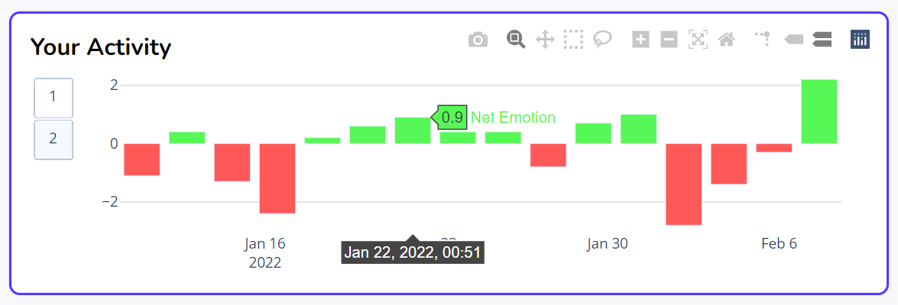
Dashboard Page (2)
(1) Under “Your Activity” Section, there are 2 different graphs to choose from.
(2) The default graph is a histogram that shows the total number of emotions predicted for every period of time. They are separated by the different emotion types. Clicking on the legend on the right can even filter out or in the emotions of interest.
(3) The second graph can be accessed by clicking the “2” button on the left. It is a bar chart that shows the net positive and negative emotions over certain periods of time. For example, the above figure shows that the user has a net emotion of 0.9 around 22 Jan.

Slide 14
APIs
POST /api/predict: Receives an image and returns the prediction
POST /api/history/add: Adding new history to the database
GET /api/history/get/<history_id>: Getting the history by its ID
GET /api/history/<user_id>: Getting all history of a particular user (with pagination & filters)
DELETE /api/history/delete/<history_id>: Delete a history with its ID
POST /api/user/add: Register users to the database
GET /api/user/<user_id>: Get the user’s information
GET /api/user/all: Get all users’ information
DELETE /api/user/delete/<user_id>: Delete user with his/her ID

Slide 15
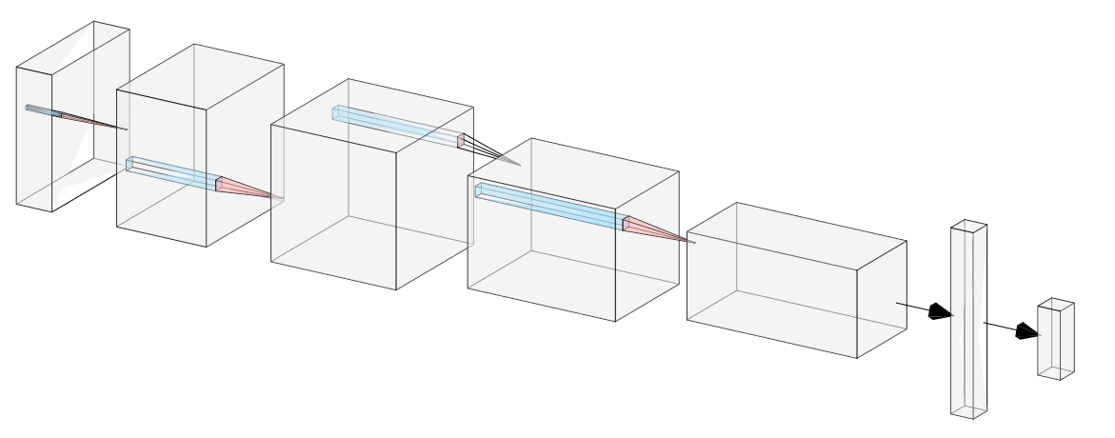
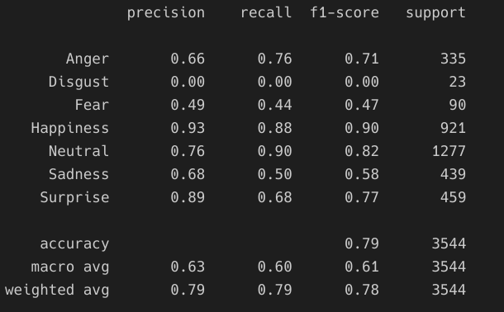
About the Model
Validation Set Accuracy: 79%
Testing Set Accuracy: 78%
Model Name: Wide Residual Network
Number of Parameters: 3.3 Million
Trained from scratch using 28K labelled images
Validated on 3.5K images
Tested on 3.5K images.

Slide 16
Testing
Testing Summary
Total Number of Tests: > 1600
Types of Tests:
Validity Testing
Range Testing
Consistency Testing
Expected Failure Testing
Unexpected Failure Testing
Validity Testing
Test that the application works as intended on real data
Example:
Test on real data and check that output is correct
Test that model results are added to user history
Range Testing
Inputs or data that are not in the range of accepted values should be rejected.
Example:
Ensure that predictions probabilities are between 0 and 1
Ensure that the date stored not before the creation of the application
Consistency Testing
Application should respond identically for the same inputs or data sent.
Example:
Ensure probabilities for each class is the same when same data is sent multiple times
Ensure that non-faces are rejected by the model as input
Expected Failure Testing
Send invalid data where the application is anticipated to return an error.
Example:
Ensure that when sending a non image file format, the app returns an error
Ensure app returns error when sending images with no face
Unexpected Testing
Application ability to handle unexpected behaviour (e.g. corrupted data, broken disk)
Example:
Ensure app returns appropriate error on accessing non-existent or unauthorized endpoints
Ensure app returns appropriate error on receiving corrupted data

Slide 17
DOAA CA2
Thank You
Project Name: Emotive

